Slide 1

Frequency Distribution Analysis of the Nuclear Areas of tumor cells expressing ITGA1 and PLK1 proteins in pancreatic cancer patient samples using AI tools and R.
Tolu & Shoma

Slide 2
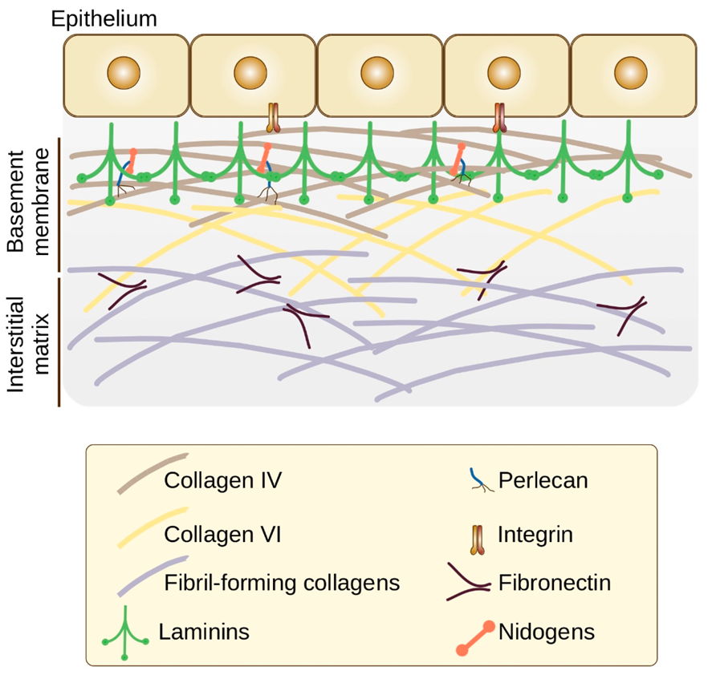
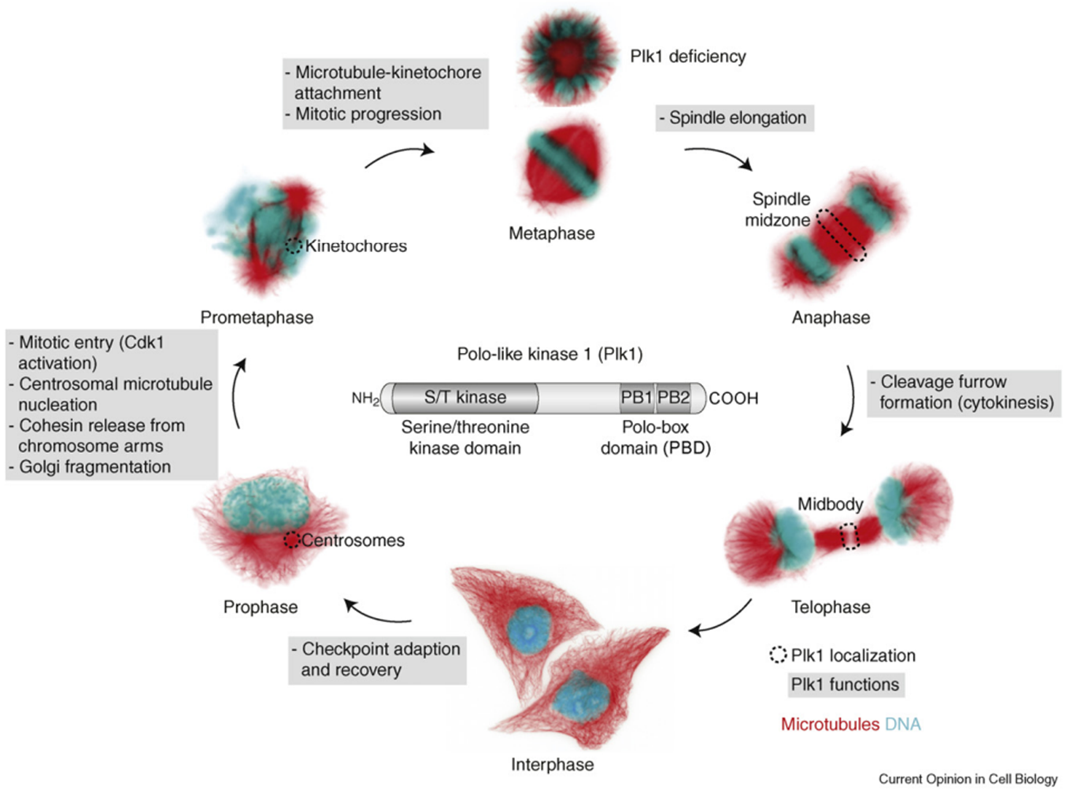
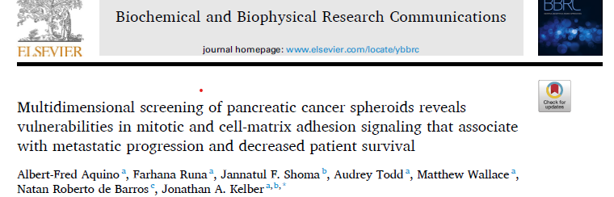

Slide 3
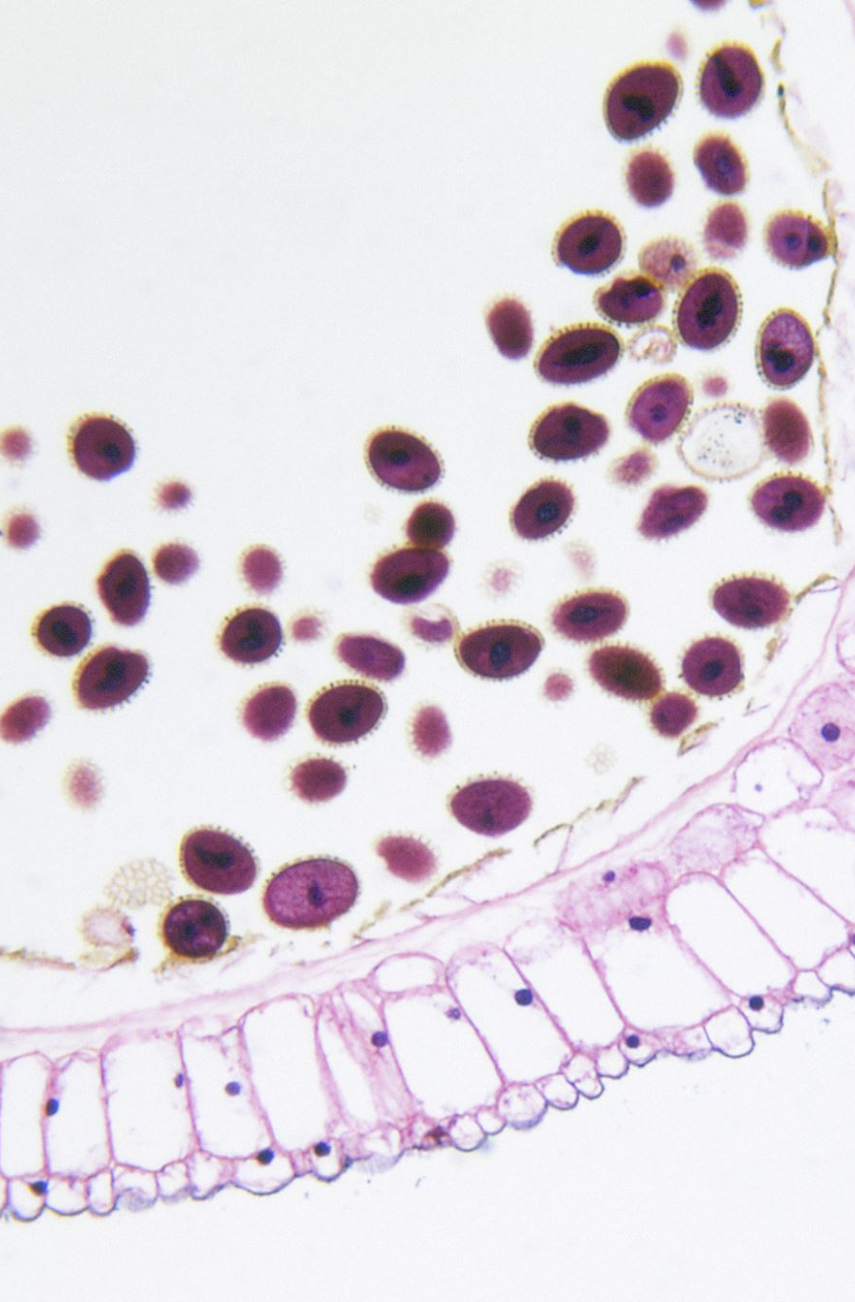
How are the ITGA1 and PLK1 proteins co-expressed within the tumor cell compartment of pancreatic cancer patient samples.

Slide 4
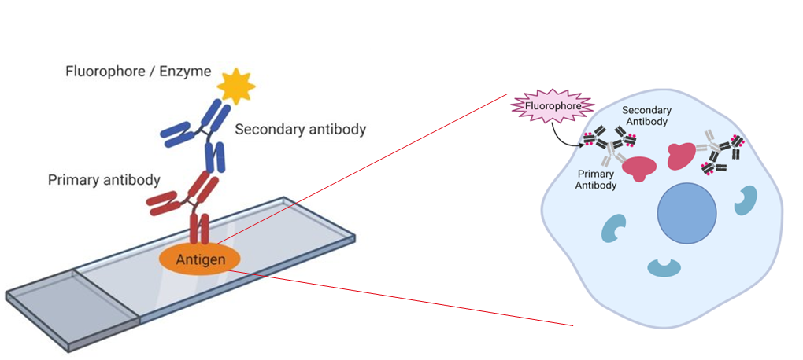
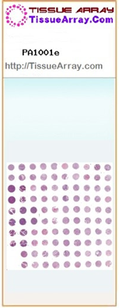
Workflow of the Experiment

Slide 5
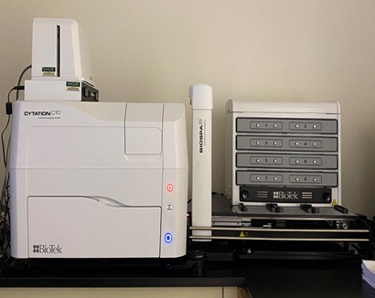

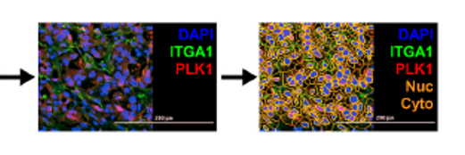

Workflow of the Experiment

Slide 6
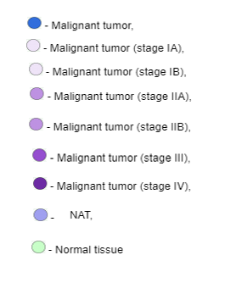
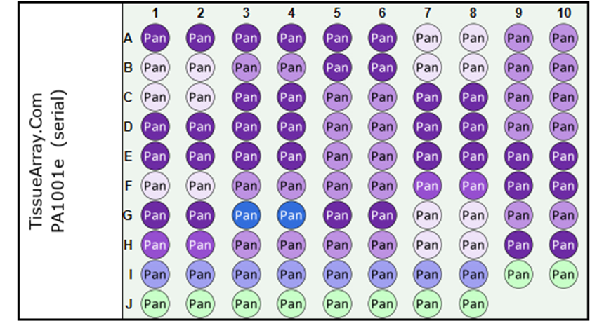
Workflow of the Experiment

Slide 7
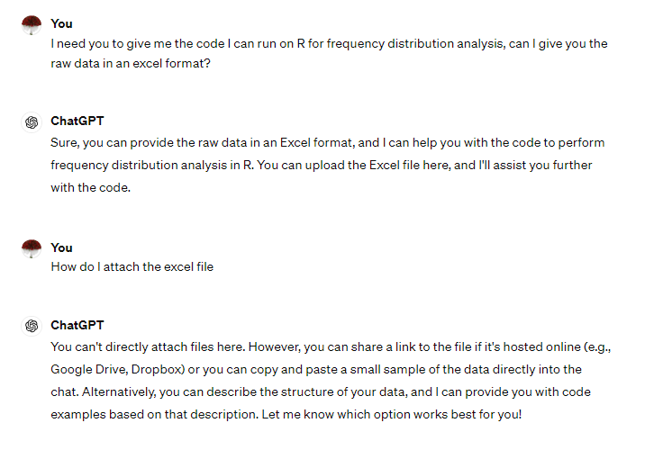
Data format for ChatGPT

Slide 8
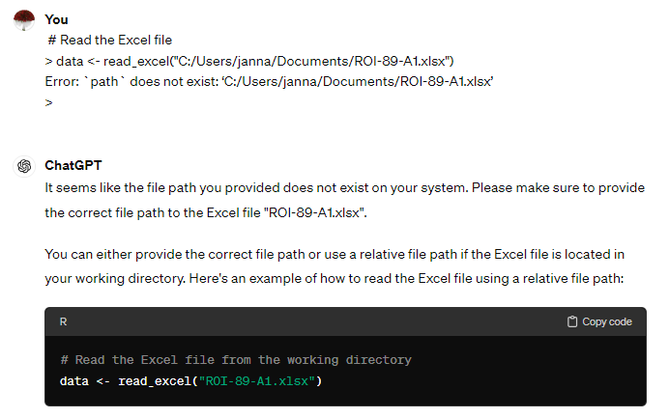
R-Path

Slide 9
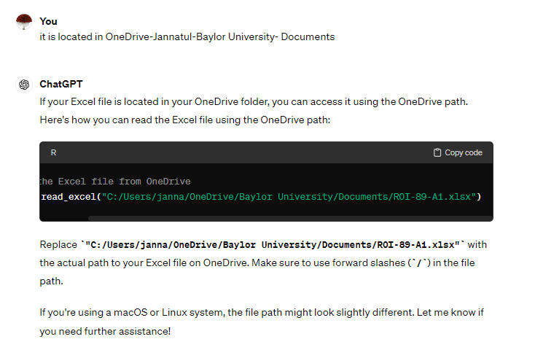
R-Path

Slide 10
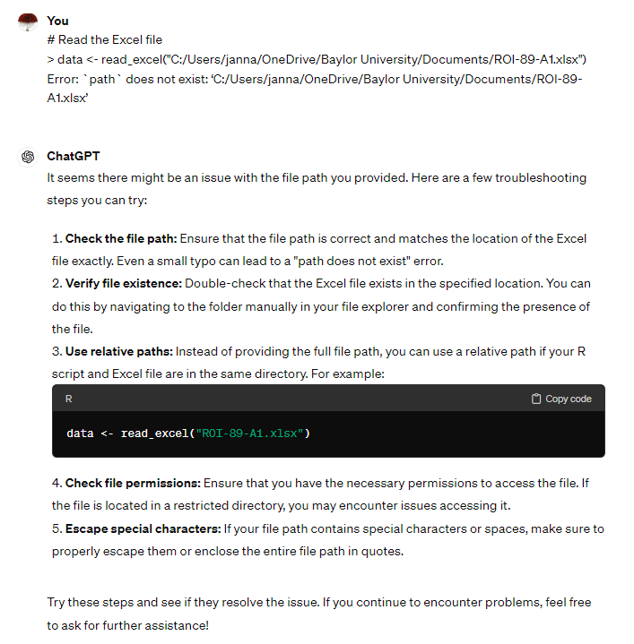

Slide 11
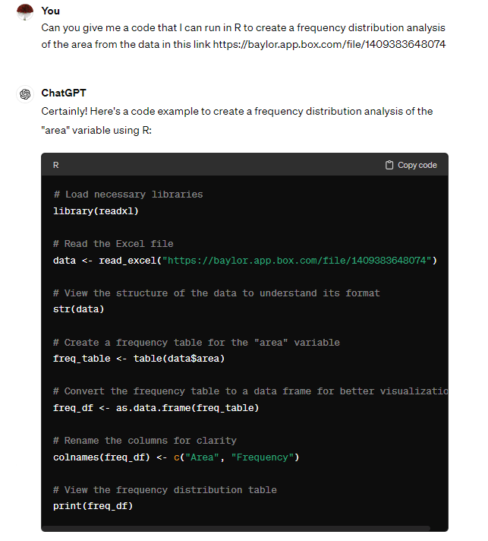
Frequency distribution code

Slide 12
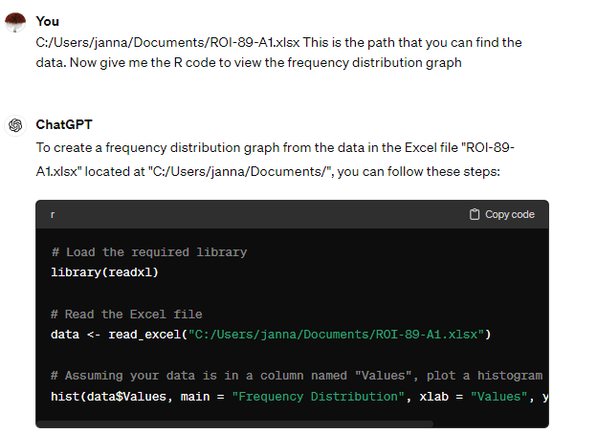
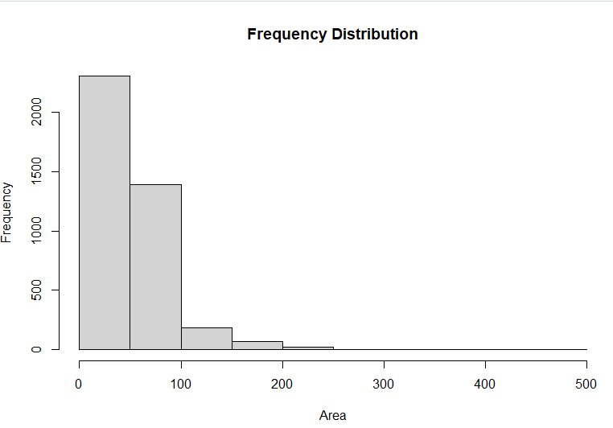
Graphing

Slide 13
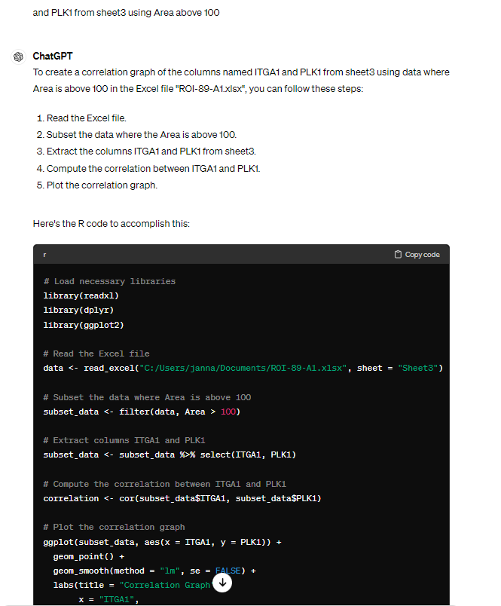
Correlation between ITGA1 and PLK1 using area above 100

Slide 14
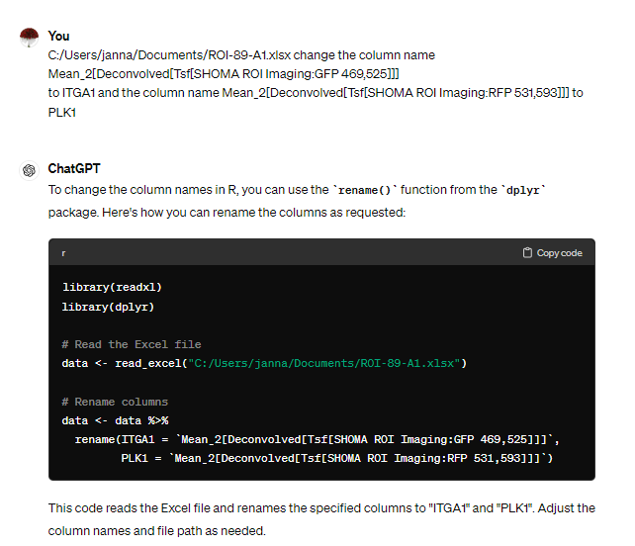
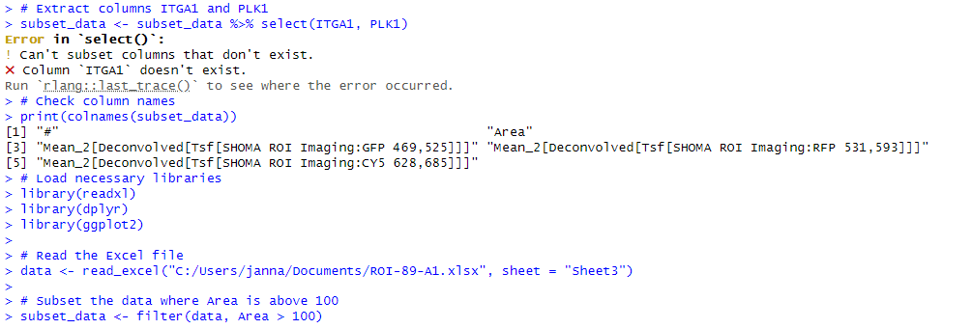
The naming is not naming!

Slide 15
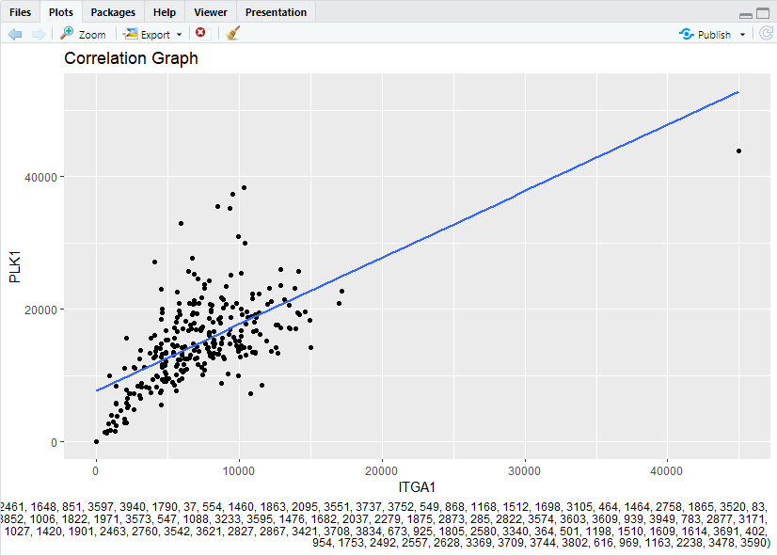
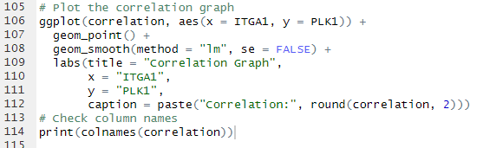
Let's try this another way

Slide 16


